Slide 1
Scraping Beer Advocate w/ Scrapy
Brandt Germann

Slide 2
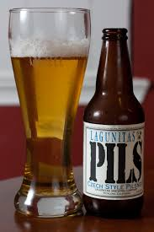
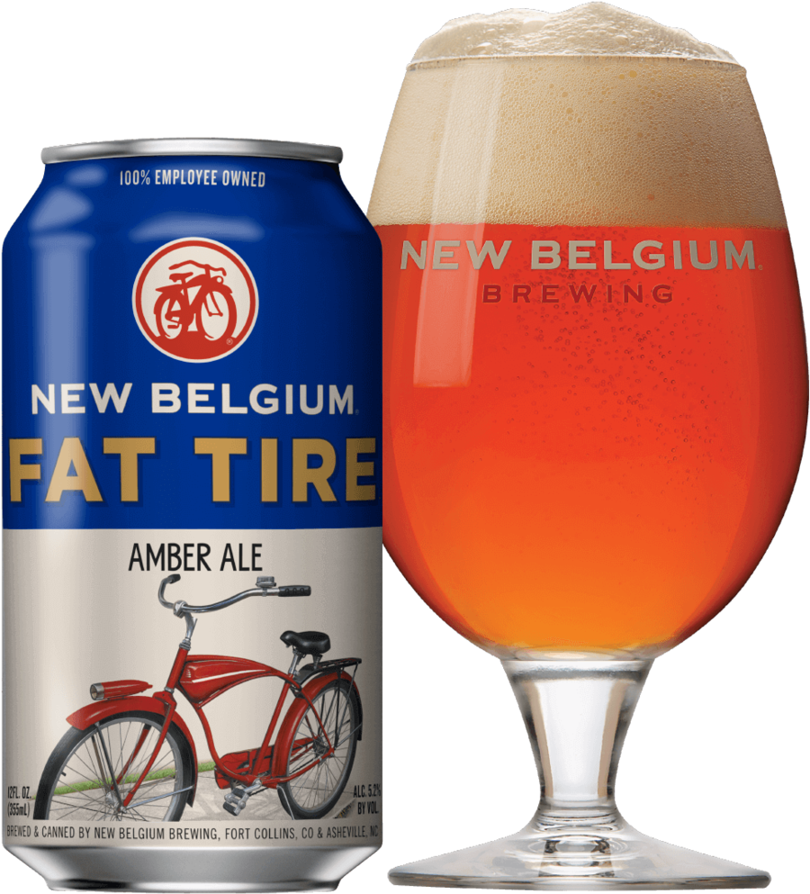

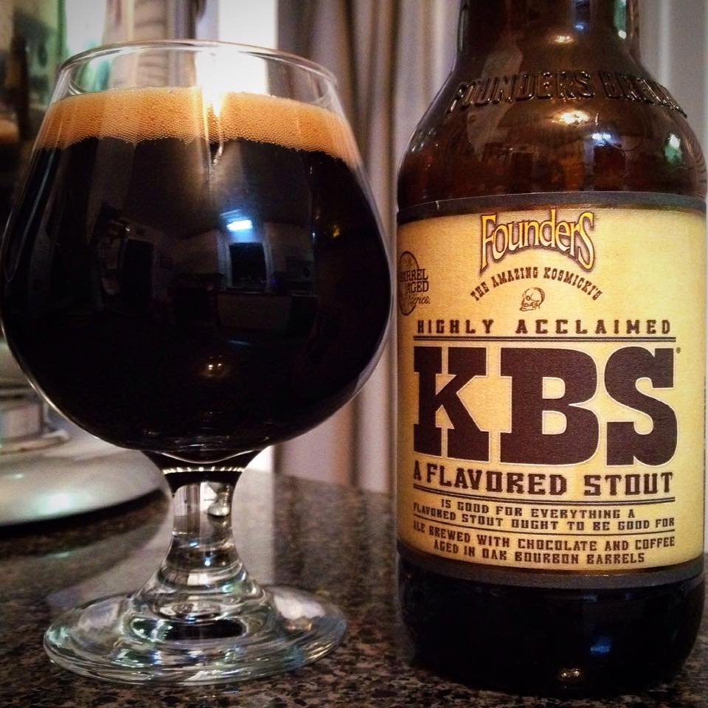
Intro
www.beeradvocate.com
Start point: Beer Advocate NY Breweries
What got me interested?
At the start of this project I set out to understand more about what types of beer are rated highly and which are generally disliked by Beer Advocate members. I also wanted to possibly modify the BA Top 100 for NY using data from the website in order to show highly rated beer of all types.

Slide 3
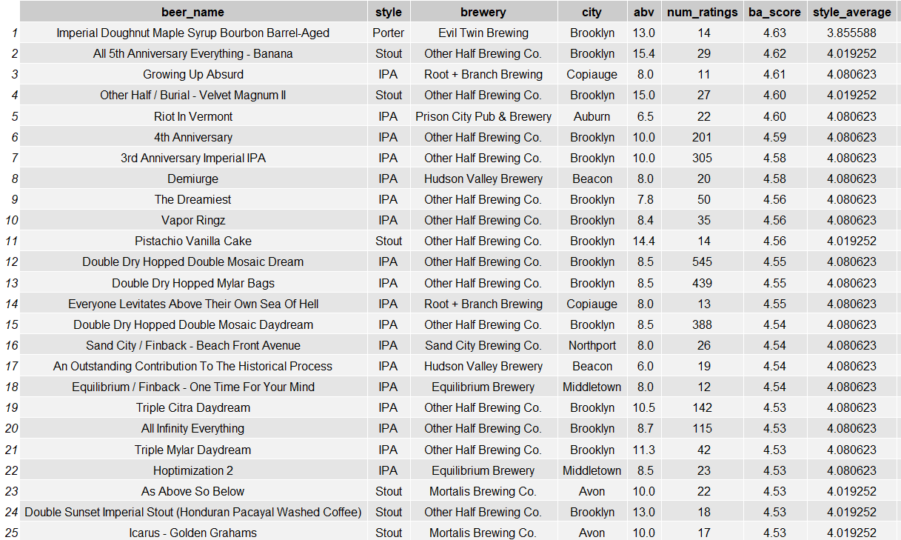
Original Site Rankings - NY

Slide 4
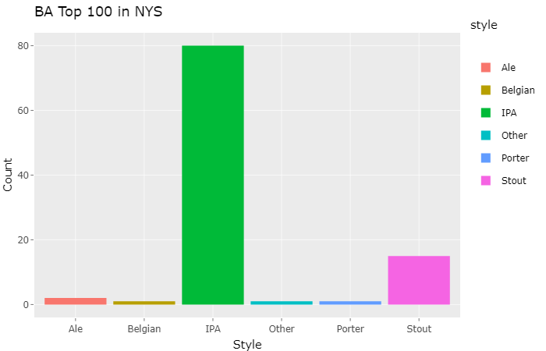
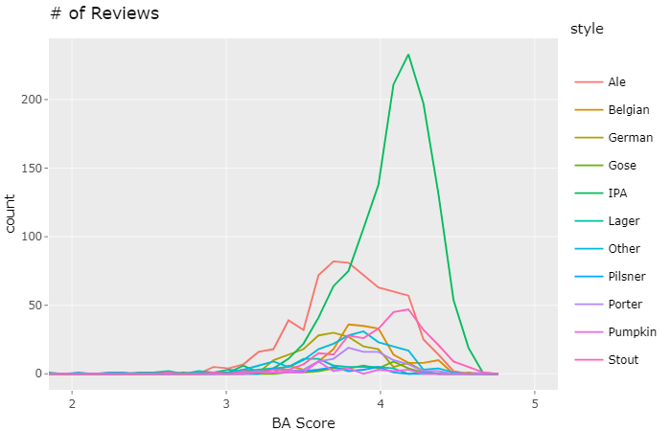
Scraped & Reclassified Data Filtered for beer with > 10 ratings

Slide 5
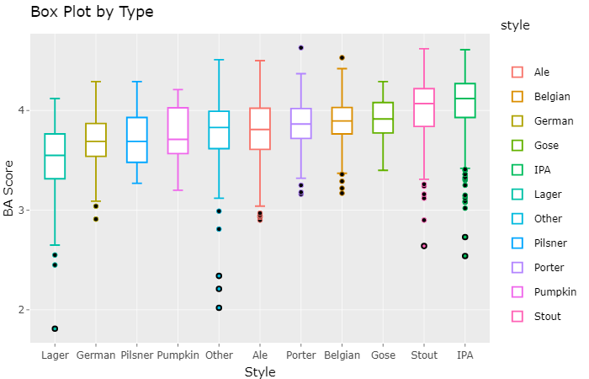
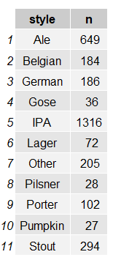

Slide 6
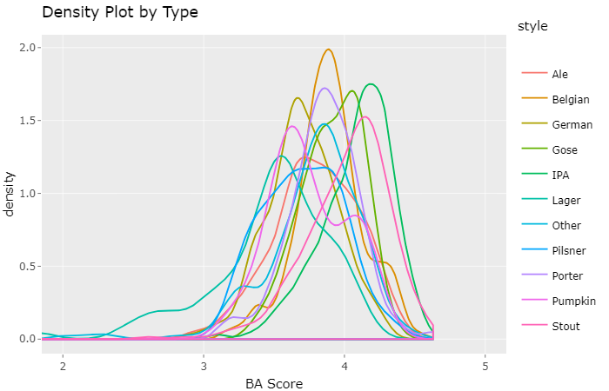
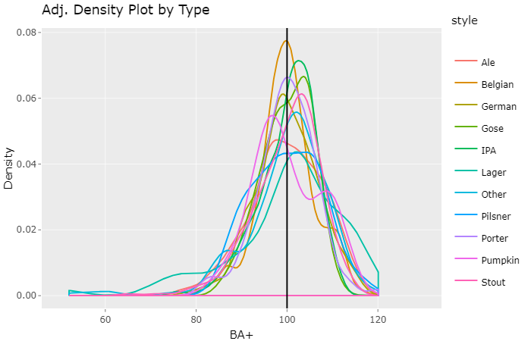
Adjusted BA Score BA+ = BA Score / Style Average * 100 average BA+ = 100 for each style

Slide 7
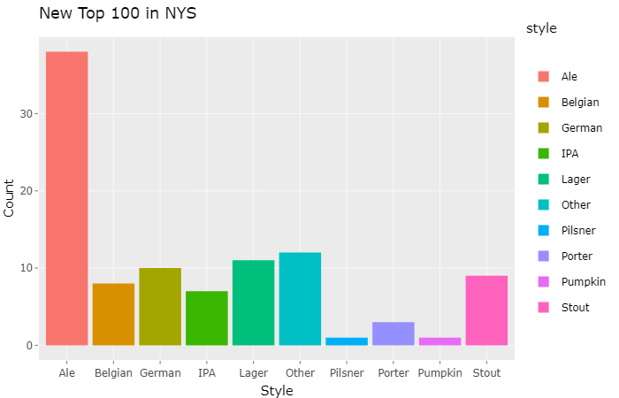
NY Top 100 Revisited

Slide 8
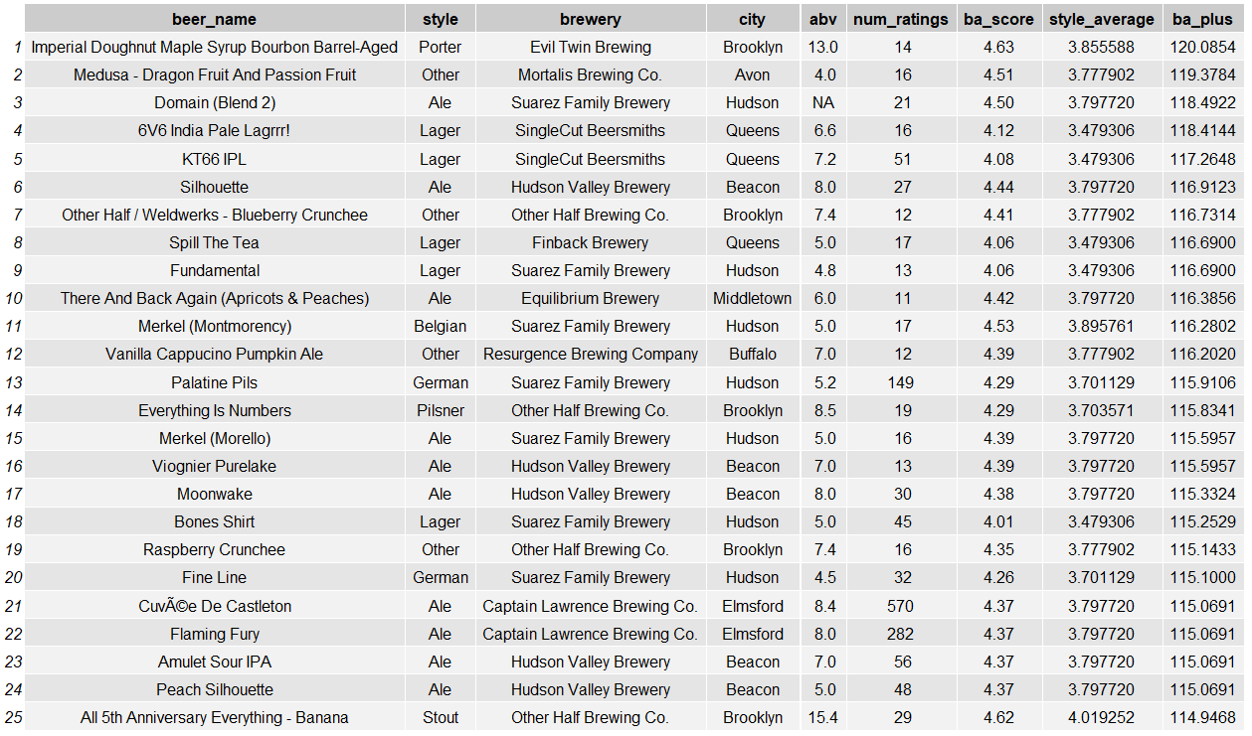
Result Table – NY Leaders

Slide 9
In the future…
Entire USA
Break ales and IPA into more sub groups
Scrape brewery websites for what is currently available on tap, then join tables to show BA+

Slide 10
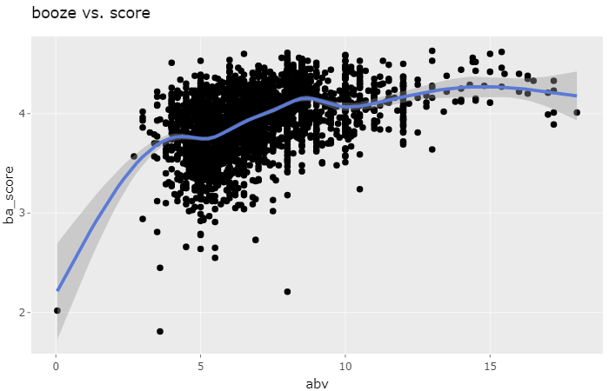
Questions?

